Slide 1
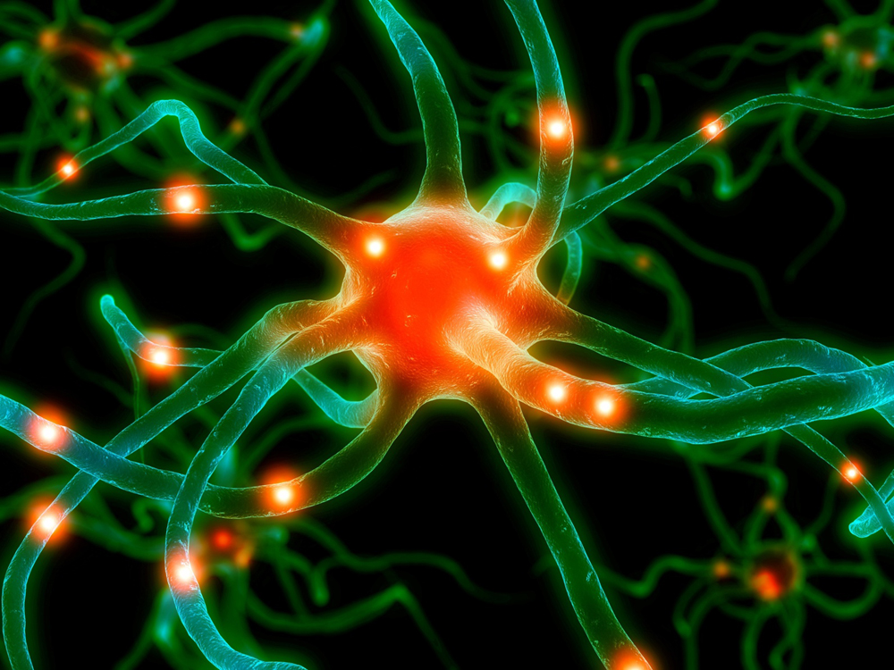
PTA/OTA 106 Unit 1 Lecture 2

Slide 2
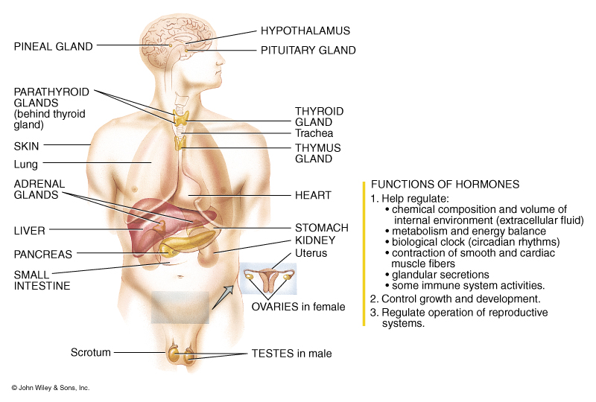
Introduction to the Endocrine System

Slide 3
Hormone Interactions
Synergistic Effect:
Two hormones acting together have a greater or more extensive effect.
Antagonistic Effect:
One hormone opposes the action of another hormone

Slide 4
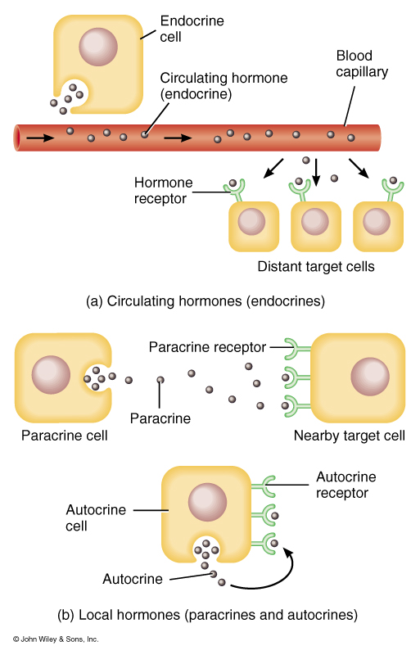
Patterns of Hormone Action
Target cells or tissue:
Specific cells affected by a hormone
Endocrine: circulated by blood to target cells
Paracrine: Hormones that affect neighboring cells
Autocrine: Hormones that act on the cells that secrete them

Slide 5
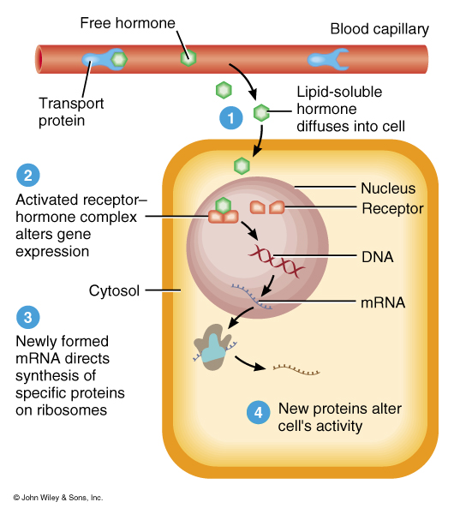
Mechanism of Action for lipid-soluble or steroid Endocrine hormones
Lipid-Soluble Hormones
Aldosterone
Calcitriol
Testosterone
Estrogen
Progesterone
T3 & T4

Slide 6
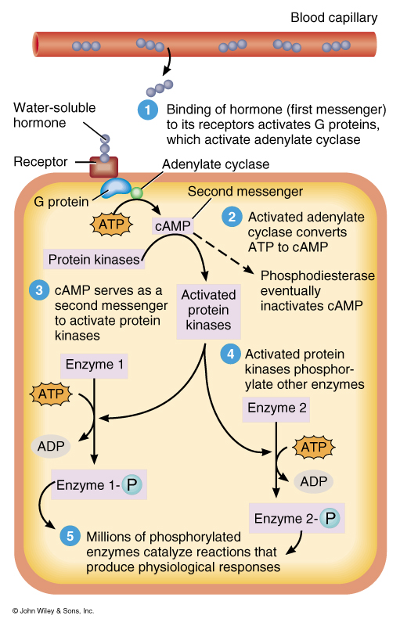
Mechanism of action for water-soluble Hormones
Anterior Pituitary Hormones
Human Growth hormone
TSH
ACTH
FSH
LH
Prolactin
MSH

Slide 7
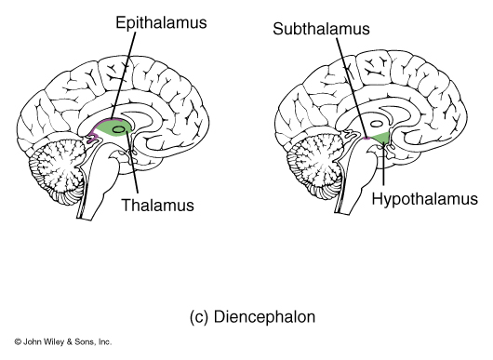
Action of the Hypothalamus as the “Master” Gland
Hypothalamus:
Controls the activity of the pituitary gland by releasing hormones called releasing or inhibiting hormones

Slide 8
Action of the Hypothalamus as the “Master” Gland
Hormone Produced:
Growth Hormone Releasing Hormone or Somatocrinin (GHRH)
Growth Hormone Inhibiting Hormone or Somatostatin (GHIH)
Thyrotropin Releasing Hormone (TRH)
Gonadotropin Releasing Hormone (GnRH)
Prolacin Releasing Hormone (PRH)
Prolacin Inhibiting Hormone (PIH)
Corticotropin Releasing Hormone (CRH)
Dopamine.
* Hormone are released to blood in the Hypophyseal portal artery which is part of the Hypophyseal portal system. *

Slide 9
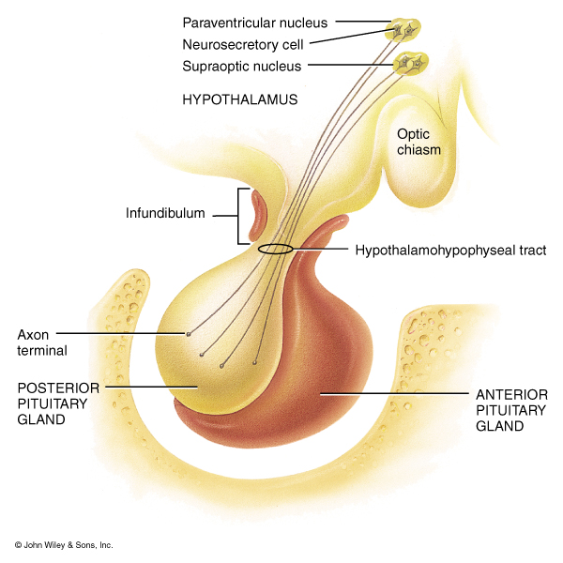
Actions of the Posterior Pituitary or Neurohypophysis
Neurohypophysis
does not synthesize hormones, however, it stores and releases two hormones produced by the neurosecretory cells of the hypothalamus
ADH
Oxytocin

Slide 10
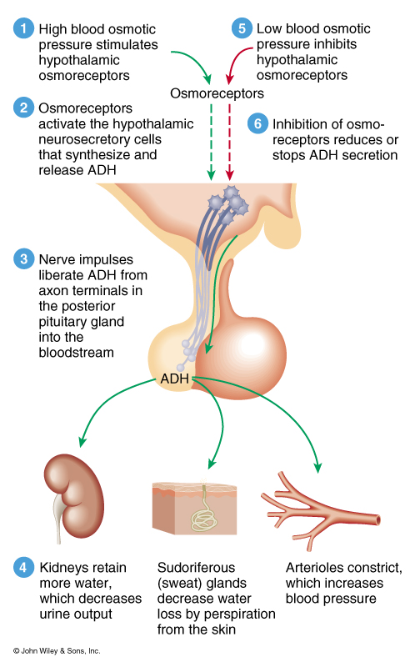
Actions and Regulation of ADH

Slide 11
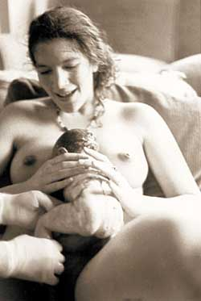
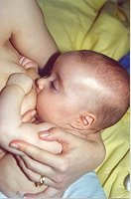
Major Actions of Oxytocin
Stimulates contraction of smooth muscle cells of the uterus during childbirth
Stimulates contraction of myoepithelial cells in the breast to cause milk letdown

Slide 12
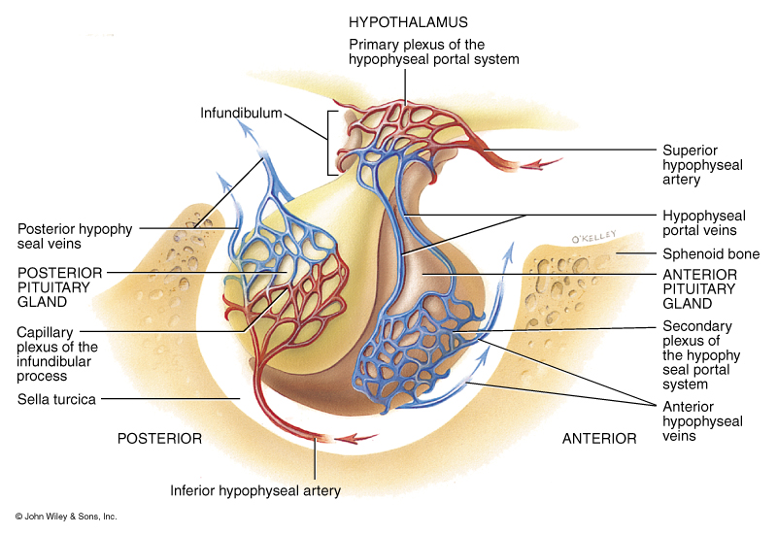
Hormones Released from the Anterior Pituitary or Adenohypophysis
Somatotrophs:
Human growth hormone or somatotrophin (hGH)
Hypothalamic control:
hGH releasing hormone (GHRH)
hGH inhibiting hormone (GHIH)
Thyrotrophs:
Thyroid-stimulating hormone (TSH)
Hypothalamic control:
Thyrotropin releasing hormone (TRH)
(GHIH)

Slide 13
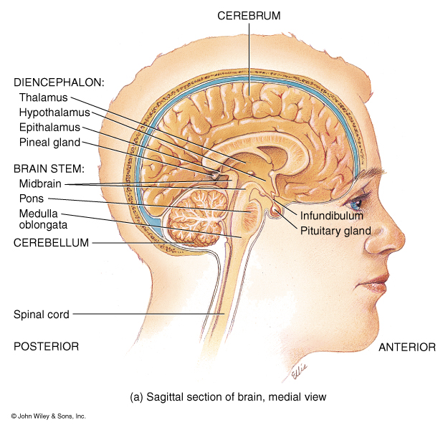
Hormones Released from the Anterior Pituitary or Adenohypophysis
Gonadotrophs:
Follicle-stimulating hormone (FSH)
Luteinizing hormone (LH)
Hypothalamic control:
Gonadotropic releasing hormone (GnRH)
Lactotrophs:
Prolactin (PRL)
Hypothalamic control:
Prolactin releasing hormone (PRH) and TRH
Prolactin inhibiting hormone PIH or dopamine

Slide 14
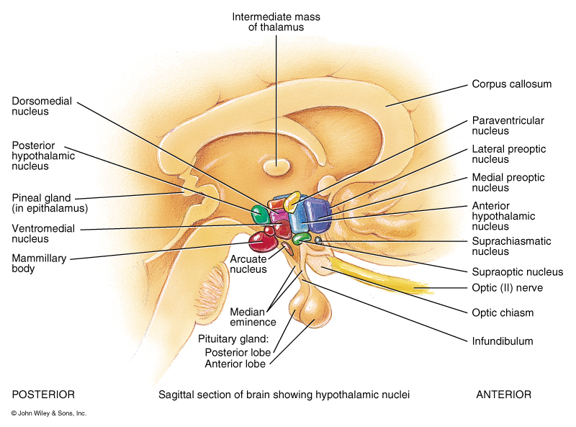
Hormones Released from the Anterior Pituitary or Adenohypophysis
Corticotrophs:
Adrenocorticotropic hormone (ACTH)
Melanocyte-stimulating hormone (MSH)
Hypothalamic control:
Corticotrophin releasing hormone (CRH)
For MSH inhibition dopamine

Slide 15
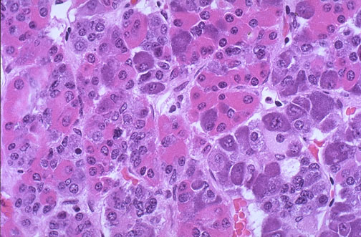
Hormones Released from the Anterior Pituitary or Adenohypophysis
Somatotrophs
Human Growth Hormone (hGH)
Hypothalamic control
hGH releasing hormone
hGH inhibiting hormone
Target Tissues:
General body cells, particularly bone, muscle, cartilage, and the liver.

Slide 16
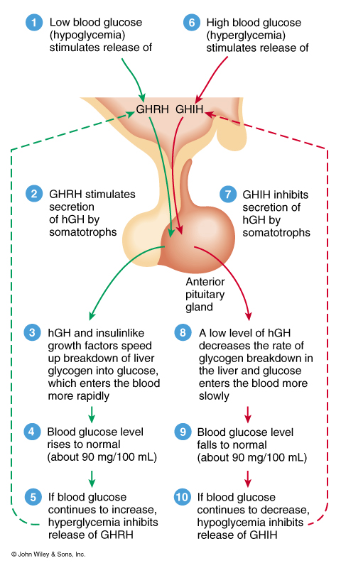
Hormones Released from the Anterior Pituitary or Adenohypophysis
Hormone affects:
promotes the synthesis of insulin-like growth factors
Controls normal growth patterns by increasing protein synthesis, lipolysis, ATP production, and carbohydrate metabolism
In adults, it help maintain muscle and bone mass and promote healing and tissue repair

Slide 17
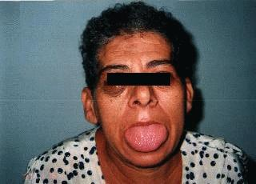
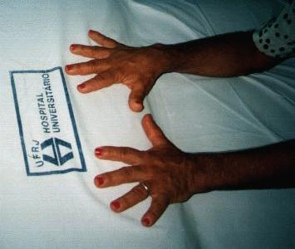
Hormones Released from the Anterior Pituitary or Adenohypophysis
Hypo-secretion:
During childhood causes pituitary Dwarfism
Hyper-secretion:
During childhood causes
Gigantism
During Adulthood causes
Acromegaly: Enlargement of the small bones of the hand and feet
Enlargement of the cranium, nose, and lower jaw
Tongue, liver, and kidneys become enlarged

Slide 18
Pituitary Dwarfism
Dwarfism is a condition in which the growth of the individual is very slow or delayed. Decreased bodily growth is due to hyposecretion of hGH. The end result is a proportionate little person, because height as well as growth of other structures are also decreased.
Can be caused by gene mutations:
Appears to be disruption on different areas of chromosome 3 and 7. Some studies have isolated defects for the production of pituitary hormones to the short arm (the "p" end) of chromosome 3 at a specific location of 3p11. Other studies have found changes on the short arm of chromosome 7.
Or tumors:
Most commonly craniopharyngioma (a tumor near the pituitary gland), children and adolescents.
Symptoms: headaches, vomiting, problems with vision (double vision), excessive drinking behaviors (polydipsia) and sleep disturbances may be common.
,

Slide 19
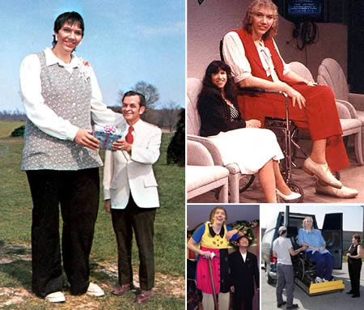
Pituitary Gigantism
Hyper secretion of human growth hormone (hGH) before the end of adolescence. People with pituitary gigantism can truly be giants. They can sometimes end up over 7 or 8 feet in height.
Typically caused by an adenoma (tumor) of the pituitary.

Slide 20
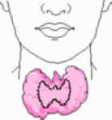
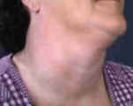
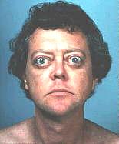
Endocrine activity of the Thyroid Gland
Hypothyroidism:
Cretinism: Physical and mental growth and development is greatly retarded
Hyperthyroidism
Toxic goiter
Graves disease with exophthalmos

Slide 21
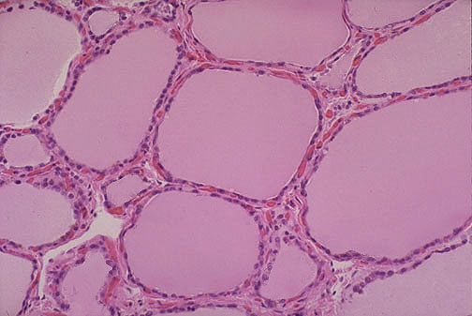
Endocrine activity of the Thyroid Gland
Follicular cells:
T3 and T4
Target Tissue;
Almost all body tissues
Hormone Affects:
Increase body Metabolism
Increases gluconeogenesis
Increases glycolysis
Increases Lipolysis
Increased basal metabolic rate
Increases Heart Rate and force of contraction

Slide 22
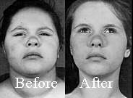
Endocrine activity of the Thyroid Gland
Hypothyroidism:
endemic goiter: (due to I2 deficiency)
Myxedema: bagginess under the eyes and swelling of the face.
Arteriosclerosis: due to increase in blood cholesterol
Cretinism: extreme hypothryoidism during infancy and childhood

Slide 23
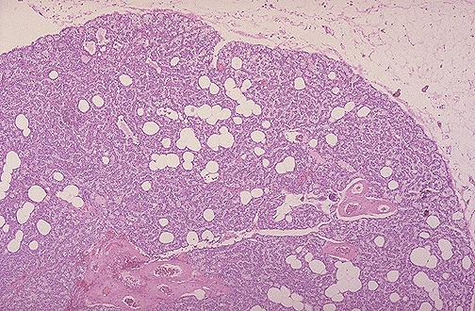
Parathyroid Hormones
Principle Cells
PTH

Slide 24
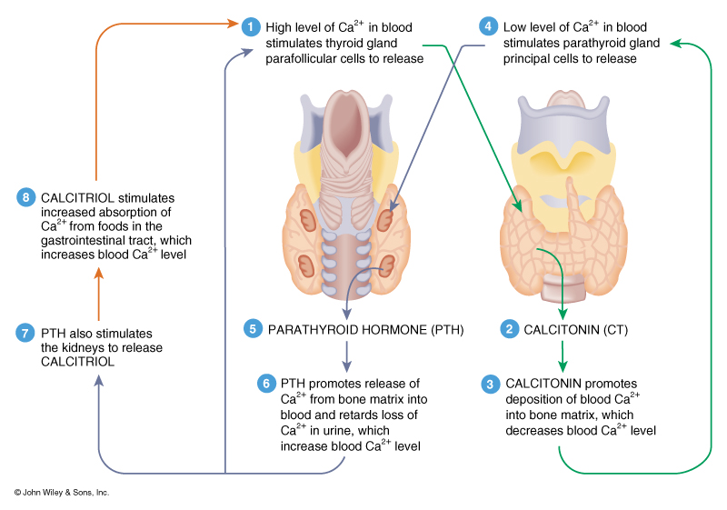
Interactions of PTH and Calcitonin

Slide 25
Changes in Calcium Balance
Electrolyte | Causes | Symptoms
Hypocalcemia Low Calcium (<4 mEq/l) Normal Range: 4.5 – 5.3 mEq/l) | Hypoparathyroidism, increased loss, decreased intake, elevated phosphate | Numbness and tingling of fingers, hyperactive reflexes, muscle tetany, bone fractures, laryngeal muscle spasms that lead to asphyxiation
Hypercalcemia High Calcium (>11 mEq/l) | Hyperparathyroidism, excessive vitamin D, Paget’s disease | Lethargy, weakness, anorexia, nausea, vomiting, polyuria, itching, bone pain, depression, confusion, and coma

Slide 26
Function of the Pineal Gland
Pineal secretion peaks between the ages of 1 and 5 and declines by 75% by the end of puberty.
Produces two hormones, serotonin and melatonin.
Melatonin increase at night, due to a light rate-limiting enzyme that converts serotonin to melatonin- serotonin N-acetyl-transferase
Melatonin has been implicated in some human mood disorders such as depression, sleep disturbances, SAD and PMS. Evidence remains some what inconclusive, but melatonin is elevated in both SAD and PMS and melatonin levels can be reduced by phototherapy (exposure to 2 to 3 hours of bright light/day)
Melatonin in other animals controls seasonal breeding patterns and sexual maturation. Some physiologists believe it may also regulate puberty in humans

Slide 27
Function of the Pineal Gland
Serotonin is produce by the Pineal, CNS neurons, and GI entroendocrine cells.
Serotonin levels increase during the day and decrease at night
Serotonin is believed to play an important role in regulation of aggression, body temperature, mood, sleep, vomiting, sexuality, and appetite.
Low levels (hyposecretion) of serotonin have been associated with aggressive and angry behaviors, clinical depression, OCD (obsessive-compulsive disorder), migraines, irritable bowel syndrome, tinnitus, fibromyalgia, and SIDS (sudden infant death syndrome).
Hyper secretion leads to Serotonin Syndrome which is potentially fatal. (usually cause by drug interactions)

